Slide 1
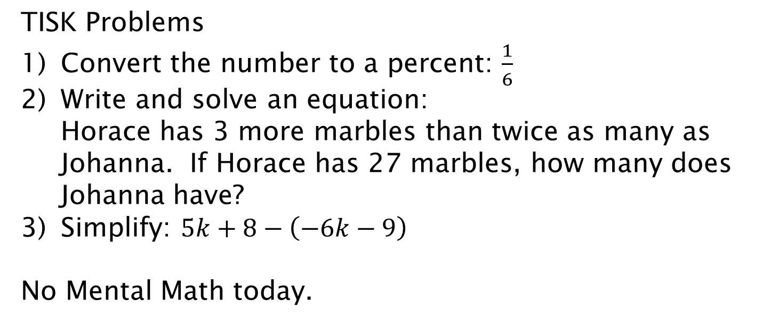
Tuesday, September 18, 2012
TISK Problems
Convert the number to a percent: $\frac{1}{6}$
Write and solve an equation: Horace has 3 more marbles than twice as many as Johanna. If Horace has 27 marbles, how many does Johanna have?
Simplify: $5k+8−\left(−6k−9\right)$
No Mental Math today.
Homework: p. 418 #17-29 odd

Slide 2
§8-4 Percent Increase & Decrease
When an amount changes, we can compare the original amount to the changed amount using a percent.

Slide 3
Lesson: Percent Increase & Decrease
Formula:
Percent Increase or Decrease
Changes the amount you get into a percent.
Then it is a Percent Increase.
Then it is a Percent Decrease.

Slide 4
Example. Find the percent of change and state whether it is an increase or a decrease.
A computer company sold a laptop for $1,200 in 1997. Now, the same laptop could be bought for $300.
300
1200
1200
Then it is a Percent Decrease.
The laptop has had a 75% decrease in price.

Slide 5
Finding the old/new amounts.
Sometimes rather than finding the percent of change, we will have to find one of the missing amounts GIVEN the percent of change.

Slide 6
Example.
A salesman increased his 150 sales from last month by 40%. How many sales did he make this month?
150
40%
150
The salesman made 210 sales this month.

Slide 7
Check Points
When Jim was exercising, his heart rate went from 70 beats per minute to 98 beats per minute. What was the percent increase?

Slide 8
Check Points
In 1999, a certain stock was worth $1.25 a share. In 2002, the same stock was worth $0.85 a share. What was the percent decrease?

Slide 9
Check Points
Sarah bought a DVD player originally priced at $450 that was on sale for 20% off. What was the sale price? (Hint: How much was the discount?)

Slide 10
Check Points
Mr. Olsen has a computer business in which he sells everything at 40% above the wholesale price. If he purchased a printer for $85 wholesale, what will be the retail price?

Slide 11
Homework
p. 418 #17-29 odd

